Slide 1

Project #1: Movie Revenue Prediction
Stony Brook University
CSE 351 Summer 2021 Final Project
Jeong Yoon Lee
Computer Science & Applied Mathematics and Statistics

Slide 2
INDEX
01. TMDB Dataset
02. Data Pre-Processing
02-1. Merge Dataset
02-2. Cleaning Data
03. Movie Trend
04. Revenue Analysis
04-1. Modeling
04-2. Analysis
05. Future Analysis
Lee Jeong Yoon, Stony Brook University

Slide 3
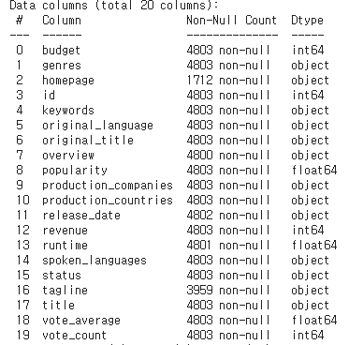
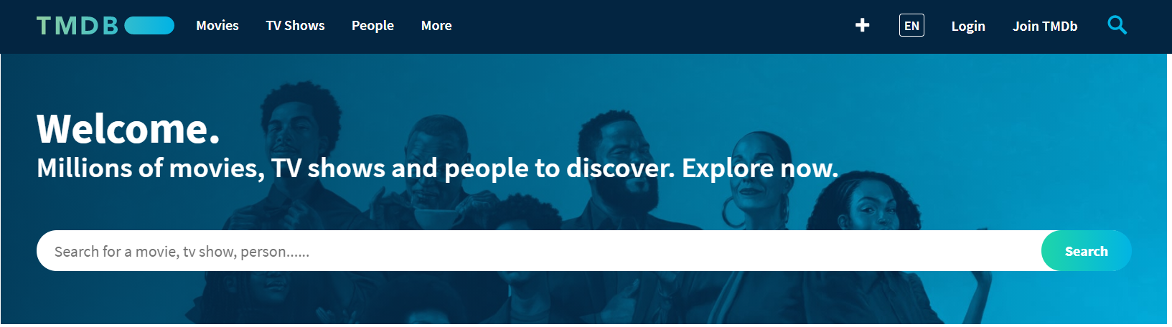
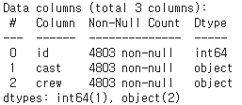
01. TMDB Dataset
02. Data Pre-Processing
03. Movie Trend
04. Revenue Analysis
05. Future analysis
01. TMDB Dataset
https://www.themoviedb.org/
<tmdb_5000_movies.csv>
<tmdb_5000_credits.csv>
→ The goal of this project is to predict revenue through related features!
Lee Jeong Yoon, Stony Brook University

Slide 4
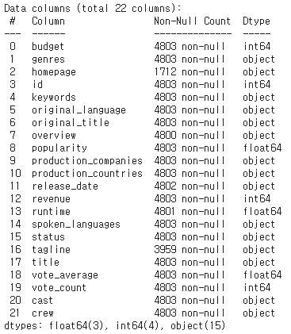
01. TMDB Dataset
02. Data Pre-Processing
03. Movie Trend
04. Revenue Analysis
05. Future analysis
02. Data Pre-Processing
Merge Datasets
Merge
+
<tmdb_5000_movies.csv>
<tmdb_5000_credits.csv>
Lee Jeong Yoon, Stony Brook University

Slide 5
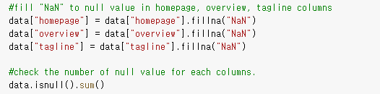
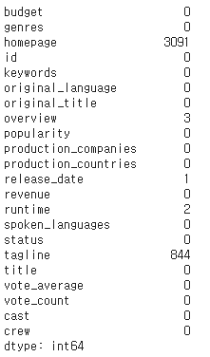
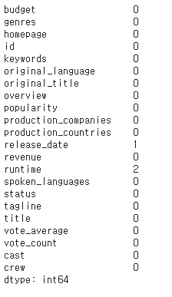
01. TMDB Dataset
02. Data Pre-Processing
03. Movie Trend
04. Revenue Analysis
05. Future analysis
02. Data Pre-Processing
Cleaning Dataset – Null Value
Lee Jeong Yoon, Stony Brook University

Slide 6
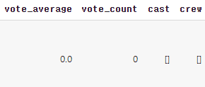
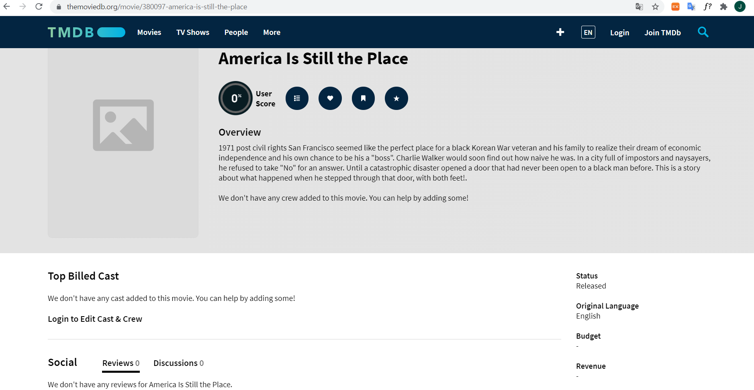
01. TMDB Dataset
02. Data Pre-Processing
03. Movie Trend
04. Revenue Analysis
05. Future analysis
02. Data Pre-Processing
Cleaning Dataset – Null Value
No Information at All!
→ Decide to drop this Row
https://www.themoviedb.org/movie/380097-america-is-still-the-place
Lee Jeong Yoon, Stony Brook University

Slide 7
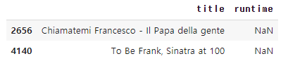
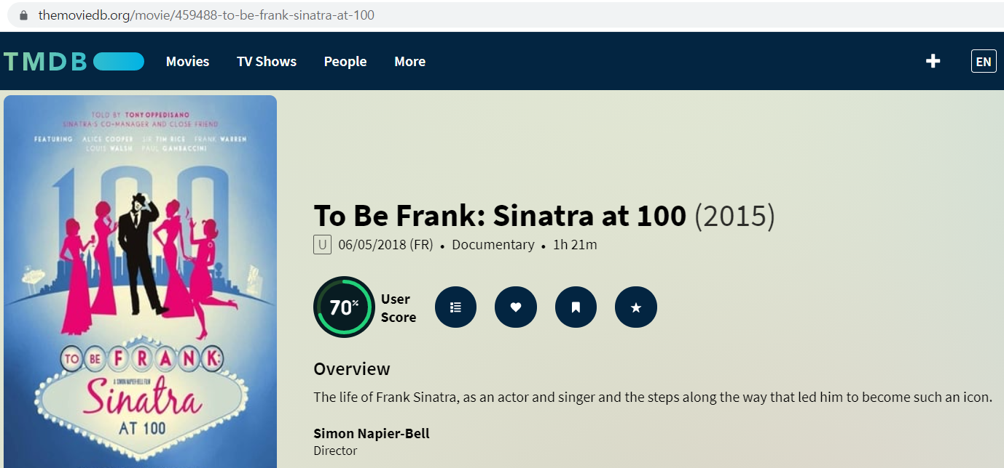
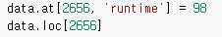
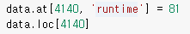
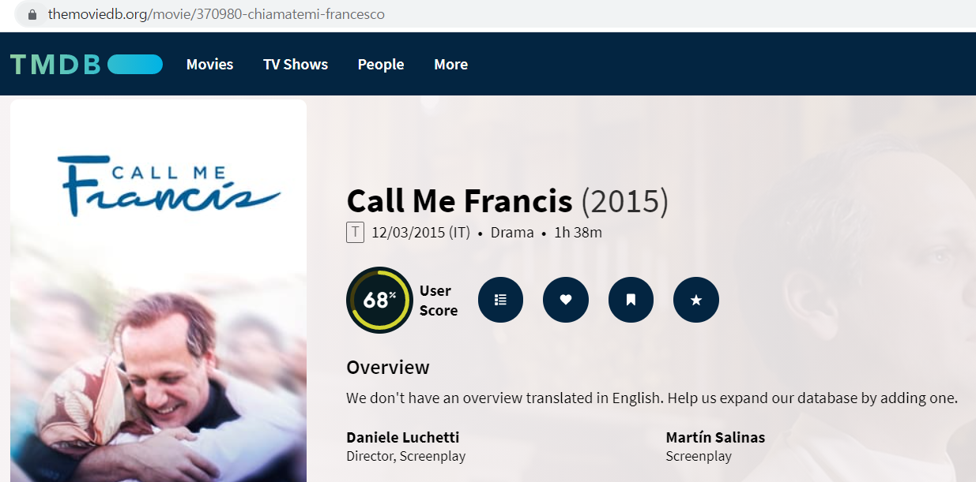
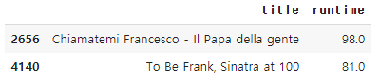
01. TMDB Dataset
02. Data Pre-Processing
03. Movie Trend
04. Revenue Analysis
05. Future analysis
02. Data Pre-Processing
Cleaning Dataset – Null Value
Fill the runtime information from TMDB website!
→
Lee Jeong Yoon, Stony Brook University
https://www.themoviedb.org/movie/459488-to-be-frank-sinatra-at-100
https://www.themoviedb.org/movie/370980-chiamatemi-francesco

Slide 8

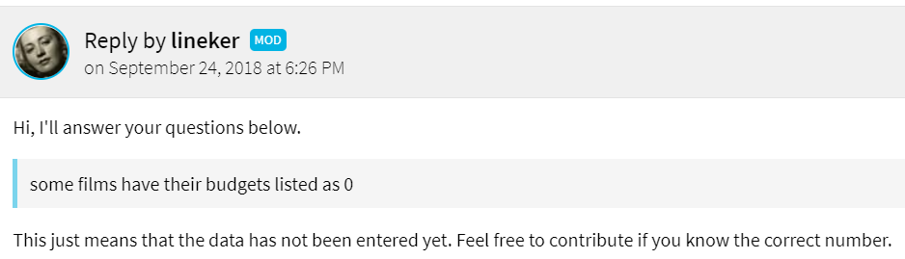
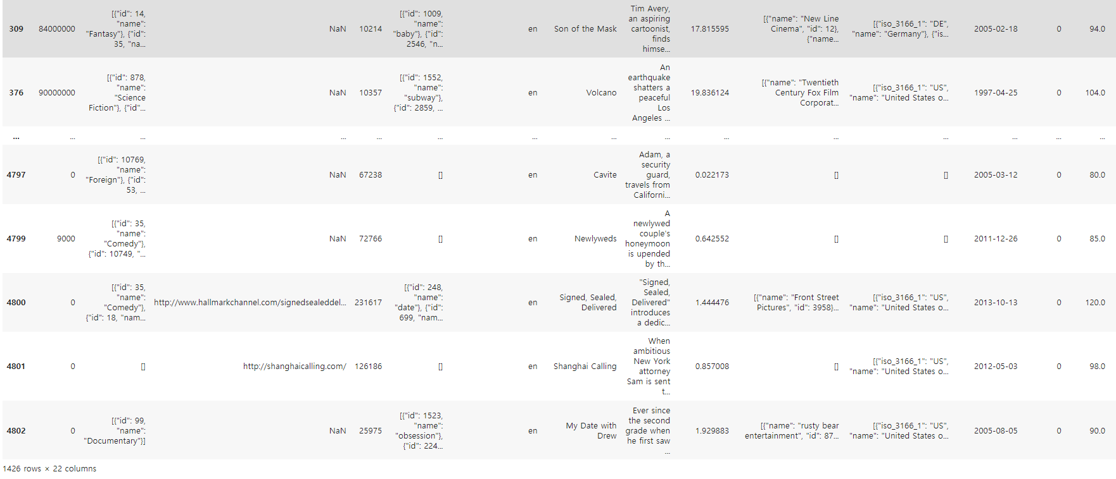
01. TMDB Dataset
02. Data Pre-Processing
03. Movie Trend
04. Revenue Analysis
05. Future analysis
02. Data Pre-Processing
Cleaning Dataset – Missing Value
https://www.themoviedb.org/talk/5ba87d119251412f0103e87b
→ 1426/4803 is too large!
Goal of this analysis is predicting revenue.
But it is too dangerous to impute these values to other values since they have all different feature values!
So, I decided to drop those rows and I
will predict these data with my model.
Lee Jeong Yoon, Stony Brook University
→ 1426 rows out of 4803 rows! Too Much!

Slide 9
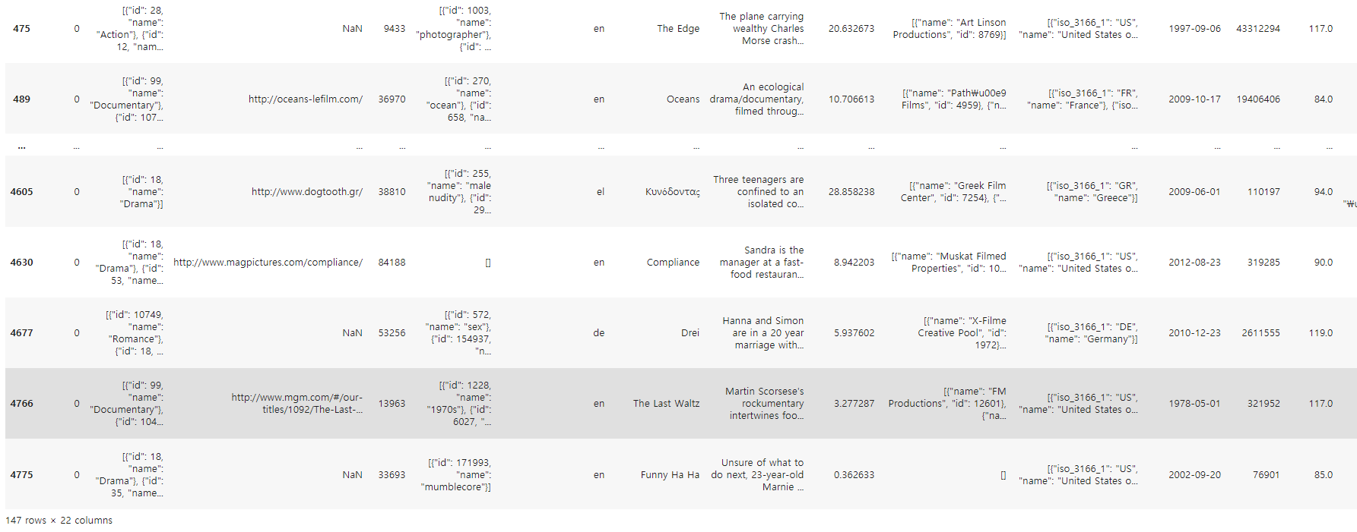
01. TMDB Dataset
02. Data Pre-Processing
03. Movie Trend
04. Revenue Analysis
05. Future analysis
02. Data Pre-Processing
Cleaning Dataset – Missing Value
→ Budget is important feature to predict revenue
We should use budget features to make revenue prediction model.
Similarly, these data don’t have any common features, so I decide to drop these rows to make it clear for predicting revenue
→ 147 rows out of 4803 rows!
Lee Jeong Yoon, Stony Brook University

Slide 10
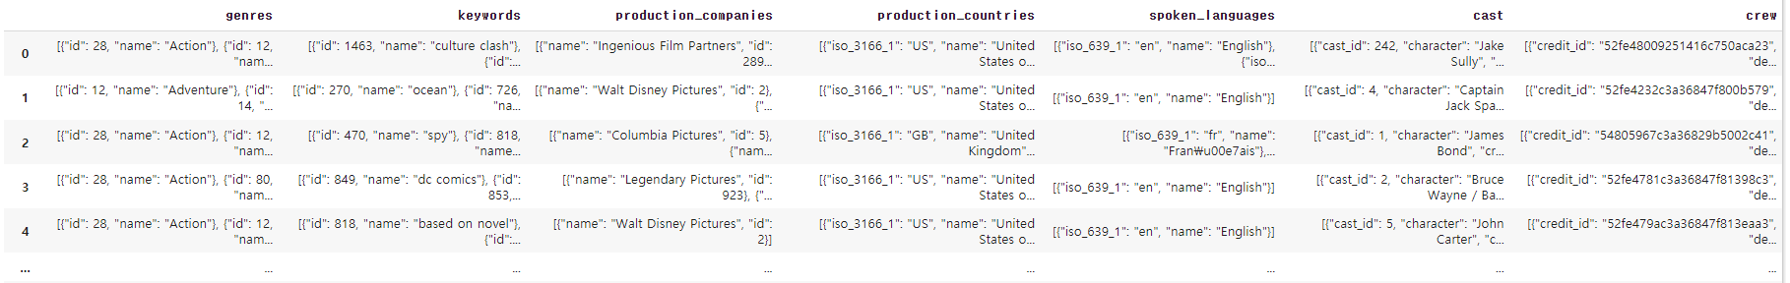
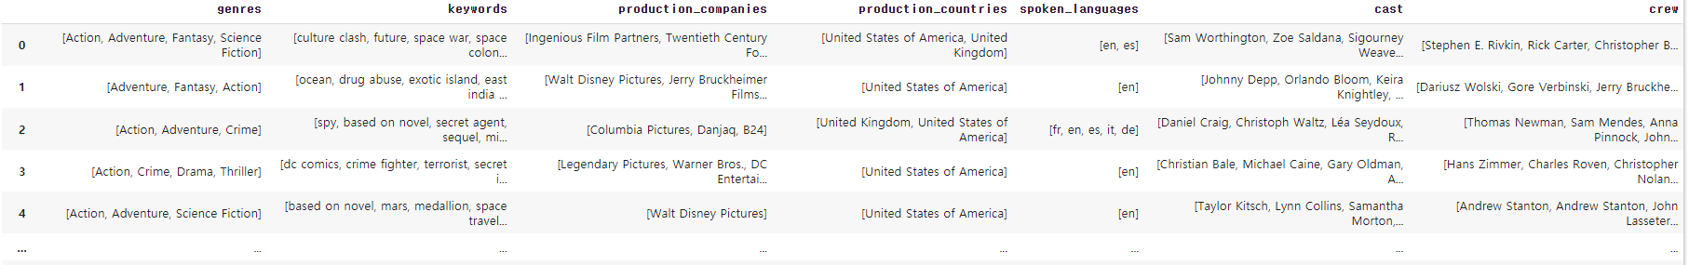
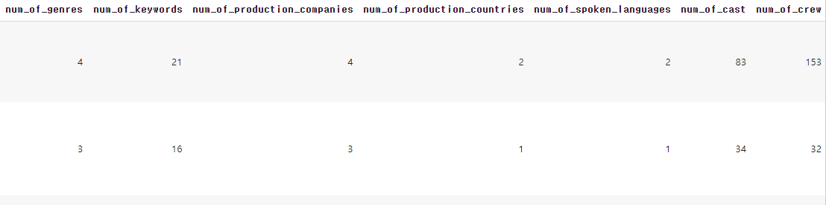
01. TMDB Dataset
02. Data Pre-Processing
03. Movie Trend
04. Revenue Analysis
05. Future analysis
02. Data Pre-Processing
Cleaning Dataset – Reformat Data
→ Changed Dictonary Data to List
→ Make New Columns
- To find relationship or correlation between these numbers and revenue
Lee Jeong Yoon, Stony Brook University

Slide 11
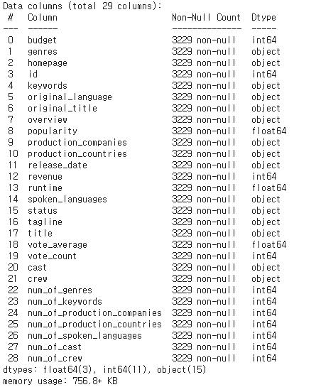
01. TMDB Dataset
02. Data Pre-Processing
03. Movie Trend
04. Revenue Analysis
05. Future analysis
02. Data Pre-Processing
Final Dataset
Lee Jeong Yoon, Stony Brook University

Slide 12
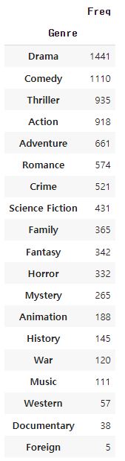
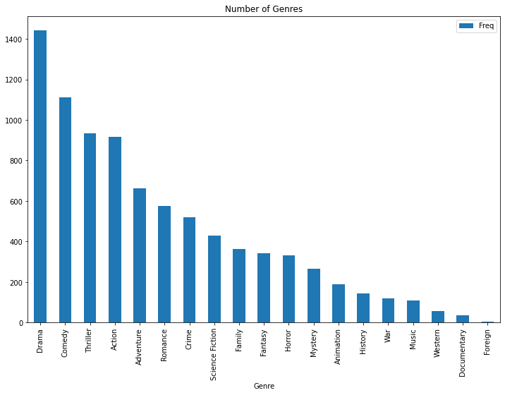
01. TMDB Dataset
02. Data Pre-Processing
03. Movie Trend
04. Revenue Analysis
05. Future analysis
03. Genre Trend
Number of Genres
Lee Jeong Yoon, Stony Brook University

Slide 13
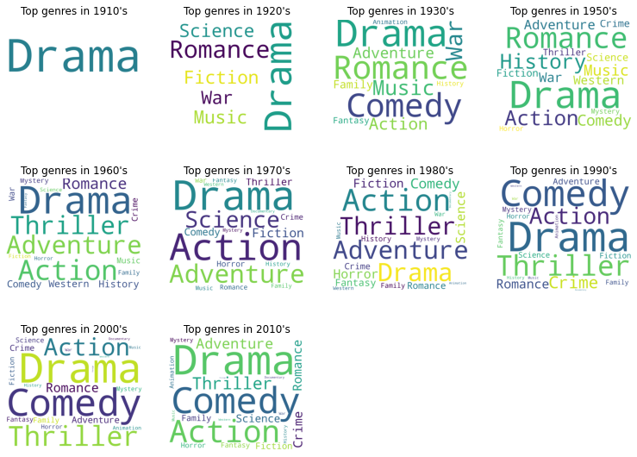
01. TMDB Dataset
02. Data Pre-Processing
03. Movie Trend
04. Revenue Analysis
05. Future analysis
03. Genre Trend
WordCloud
→10-year cycle of movie genre preference output
based on frequency of genre
Lee Jeong Yoon, Stony Brook University

Slide 14
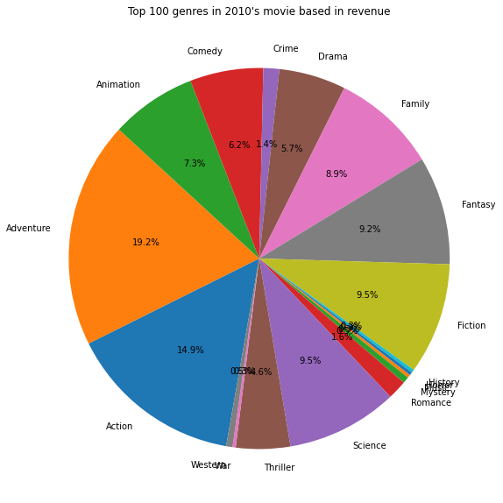
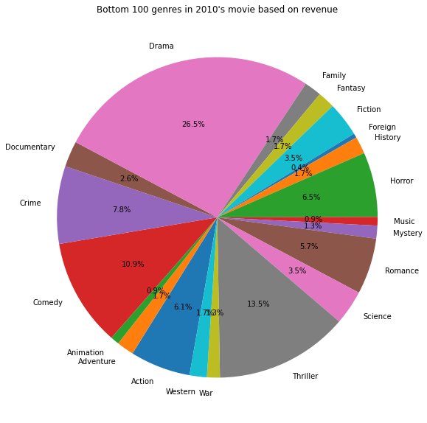
01. TMDB Dataset
02. Data Pre-Processing
03. Movie Trend
04. Revenue Analysis
05. Future analysis
03. Genre Trend
Top 100 & Bottom 100 movie genres in 2010’s based on revenue
Drama is the worst genre to get high revenue in 2010’s even Drama is the most even though Drama genre have been made so much in 2010’s
Lee Jeong Yoon, Stony Brook University

Slide 15
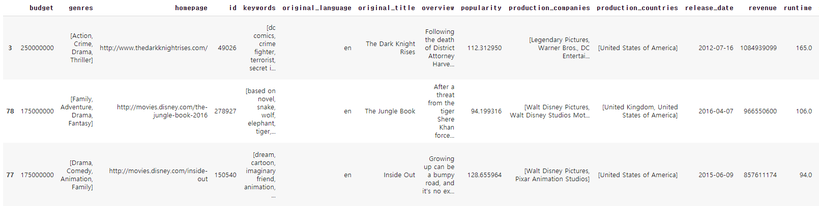
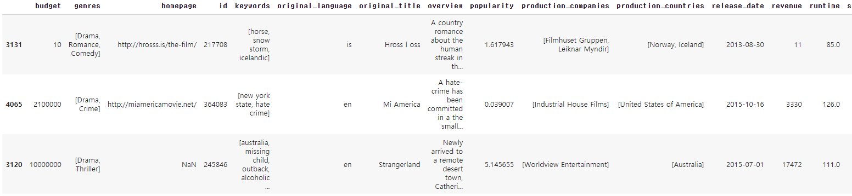
01. TMDB Dataset
02. Data Pre-Processing
03. Movie Trend
04. Revenue Analysis
05. Future analysis
03. Genre Trend
→ Top 3 Drama movies based on revenue
→ Bottom 3 Drama movies based on revenue
Lee Jeong Yoon, Stony Brook University

Slide 16
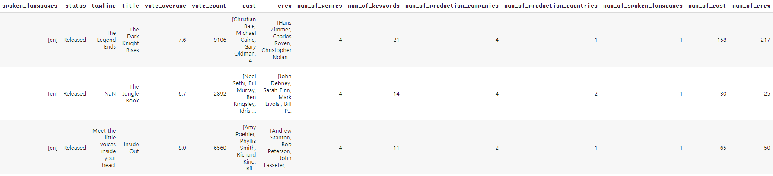
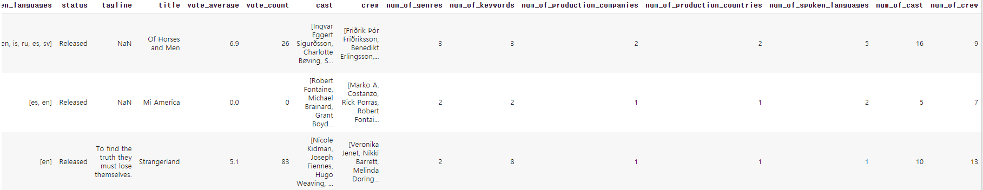
01. TMDB Dataset
02. Data Pre-Processing
03. Movie Trend
04. Revenue Analysis
05. Future analysis
03. Genre Trend
→ Top 3 Drama movies based on revenue
→ Bottom 3 Drama movies based on revenue
Lee Jeong Yoon, Stony Brook University

Slide 17
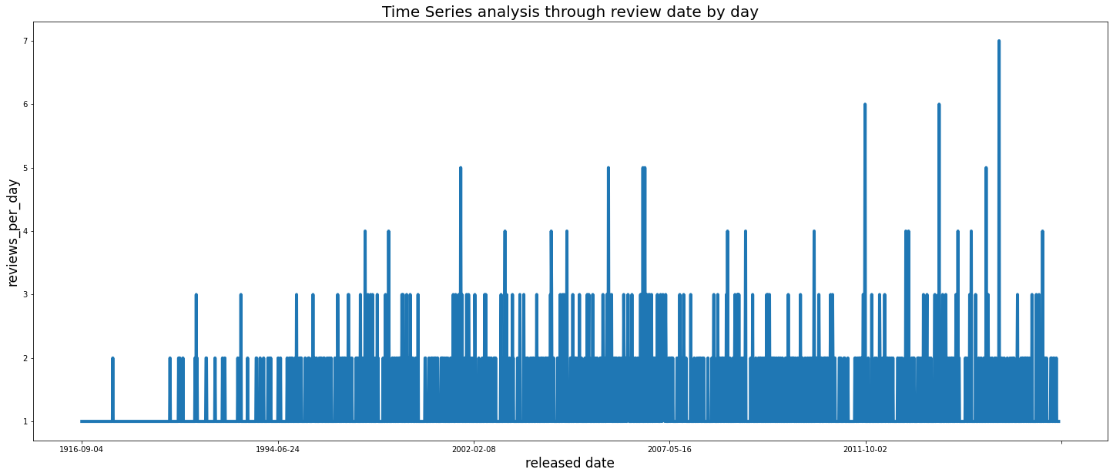
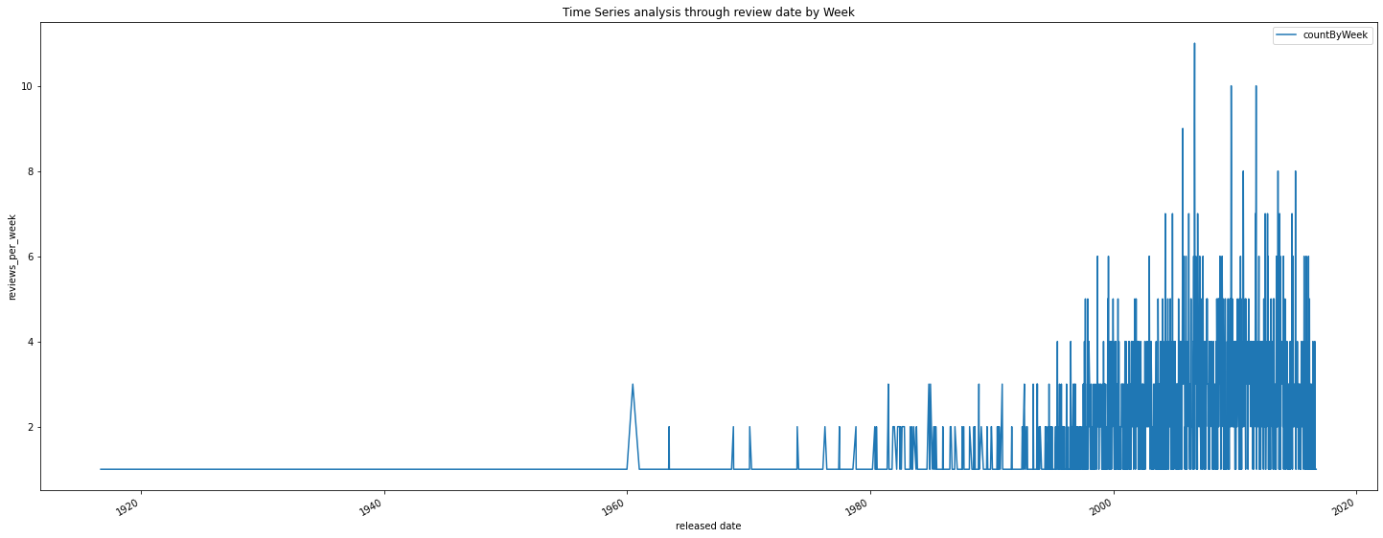
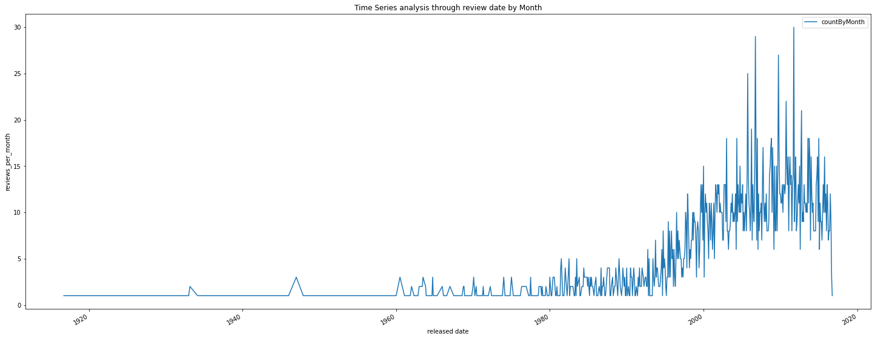
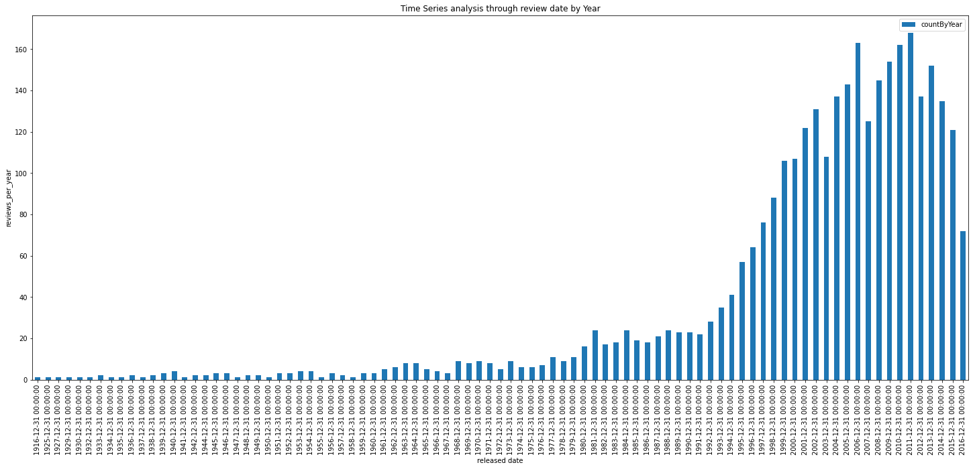
01. TMDB Dataset
02. Data Pre-Processing
03. Movie Trend
04. Revenue Analysis
05. Future analysis
- Graph based on released date of the movie by day, week, month and year.
Hard to find any seasonality in these graph.
03. Released Day Trend
The number of the released movie decreased every 10 years. → 1996(start increasing),2006(local minima),2016(local minima)
Lee Jeong Yoon, Stony Brook University

Slide 18
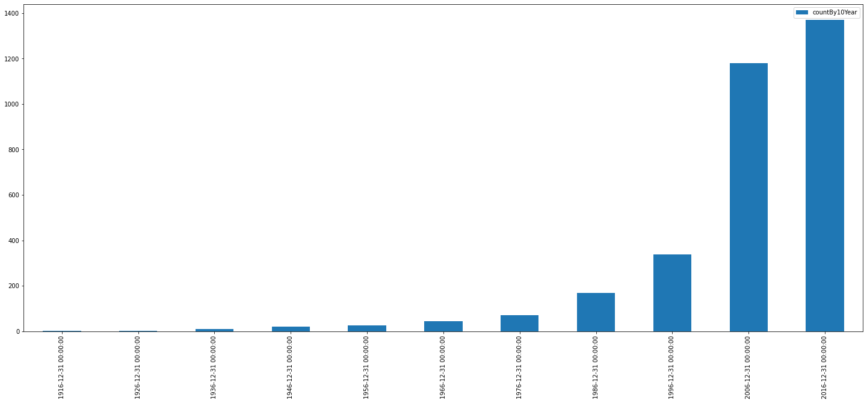
01. TMDB Dataset
02. Data Pre-Processing
03. Movie Trend
04. Revenue Analysis
05. Future analysis
03. Released Day Trend
Also check the number of released movies by 10 years
It shows the number of released movies are drastically increasing over 10 years
Lee Jeong Yoon, Stony Brook University

Slide 19
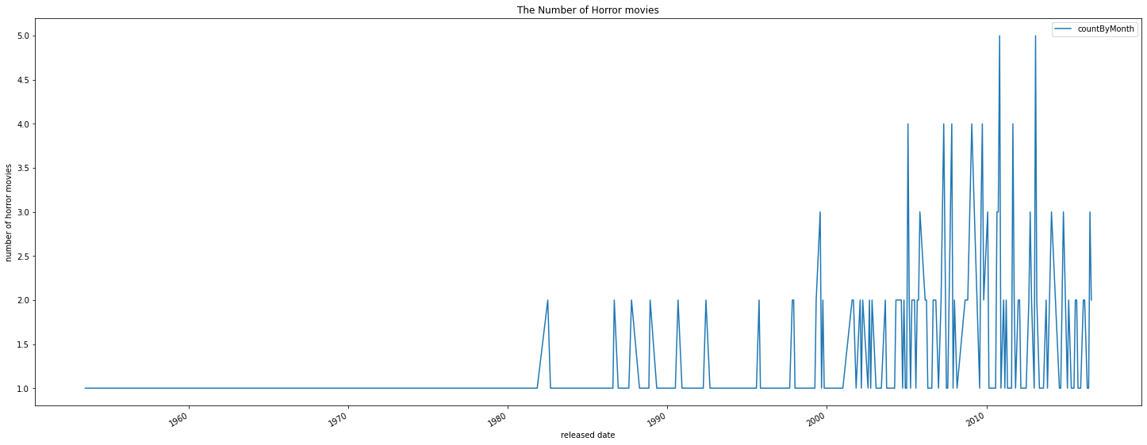
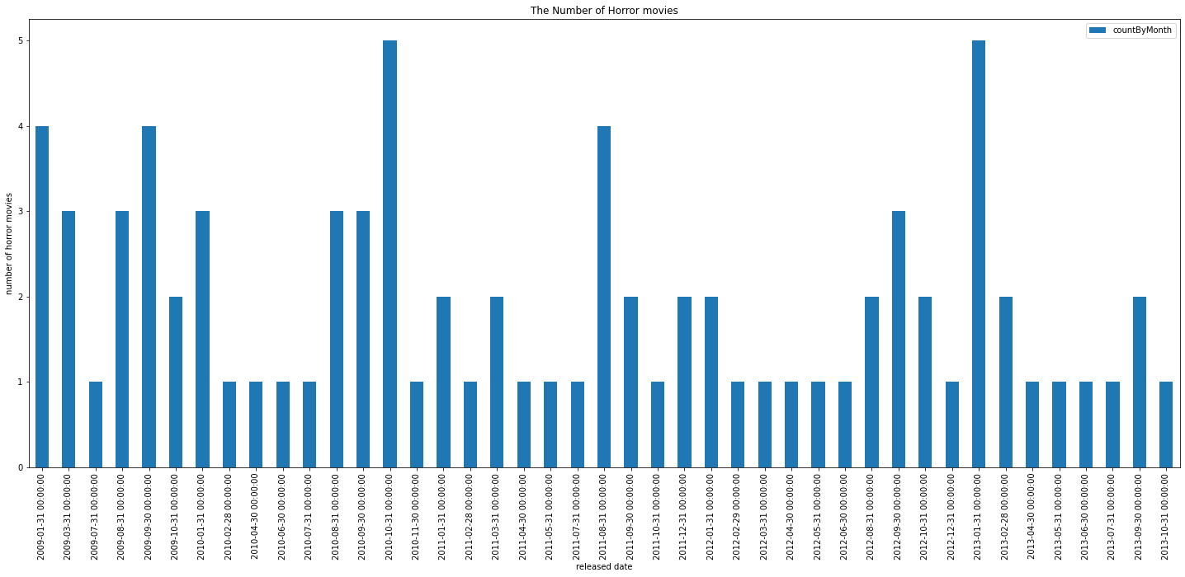
01. TMDB Dataset
02. Data Pre-Processing
03. Movie Trend
04. Revenue Analysis
05. Future analysis
03. Released Day Trend
Check seasonality of Horror movie.
We usually see horror movie in summer, and I want to check the released date of horror movie.
Checking the number of horror movies in 5 years (2009 ~ 2013).
Surprisingly, horror movies are usually released in February too.
The number of horror movies are increasing starts from August which is start of summer.
Lee Jeong Yoon, Stony Brook University

Slide 20
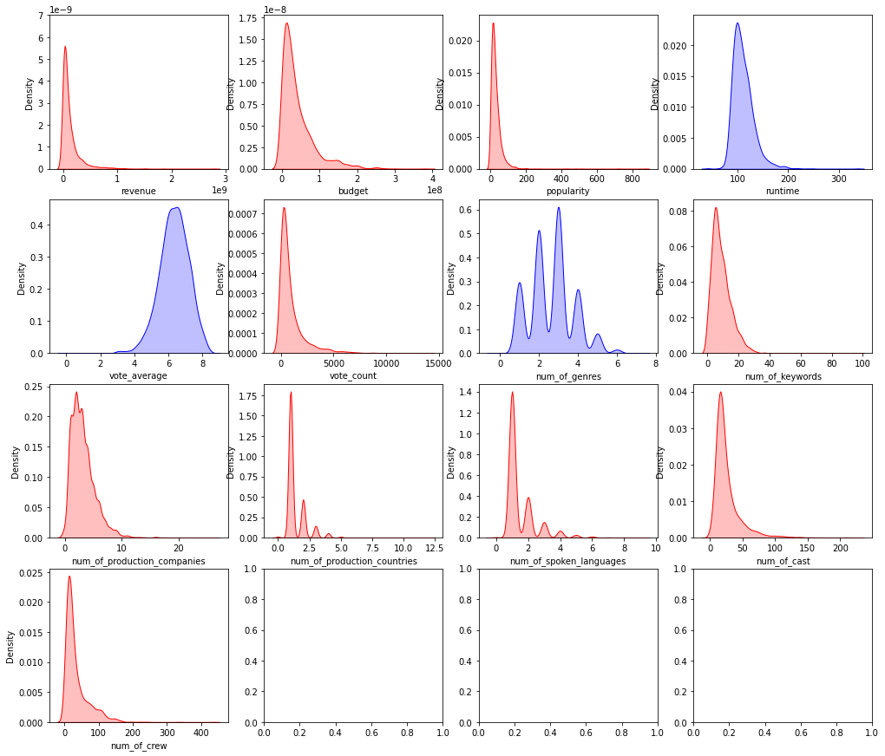
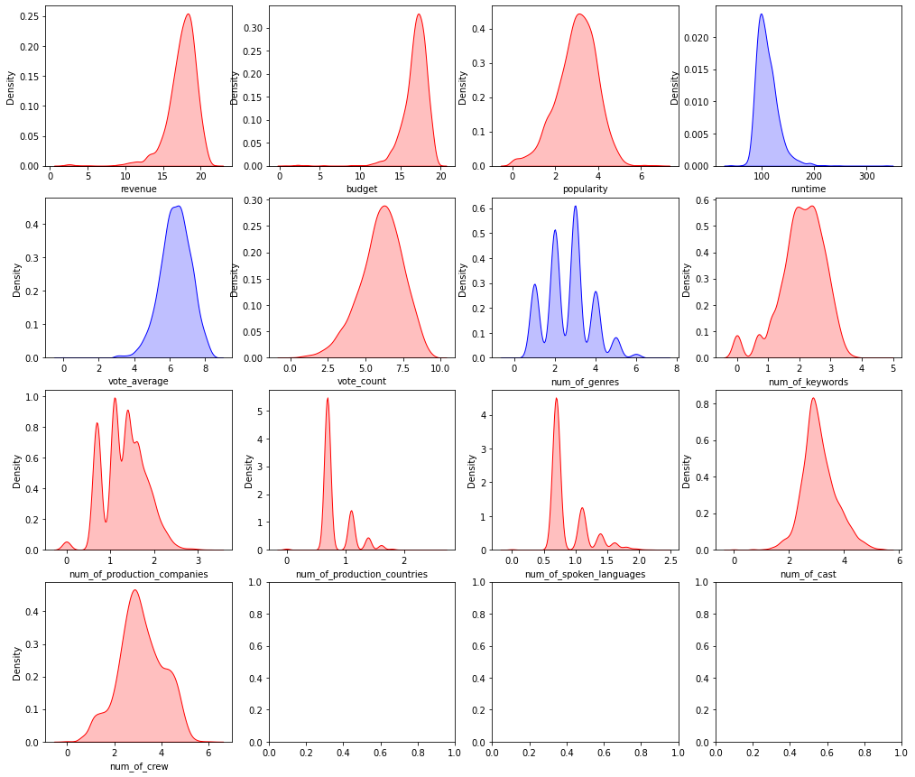
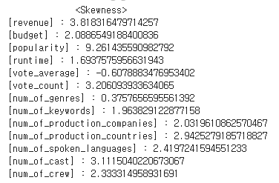
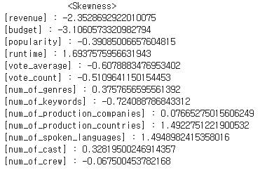
01. TMDB Dataset
02. Data Pre-Processing
03. Movie Trend
04. Revenue Analysis
05. Future analysis
04. Revenue Analysis
Power Law Distribution
Take logarithm
Lee Jeong Yoon, Stony Brook University

Slide 21
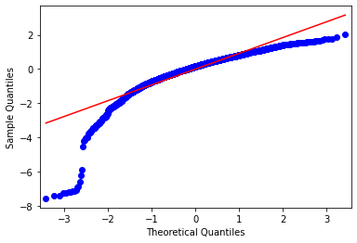
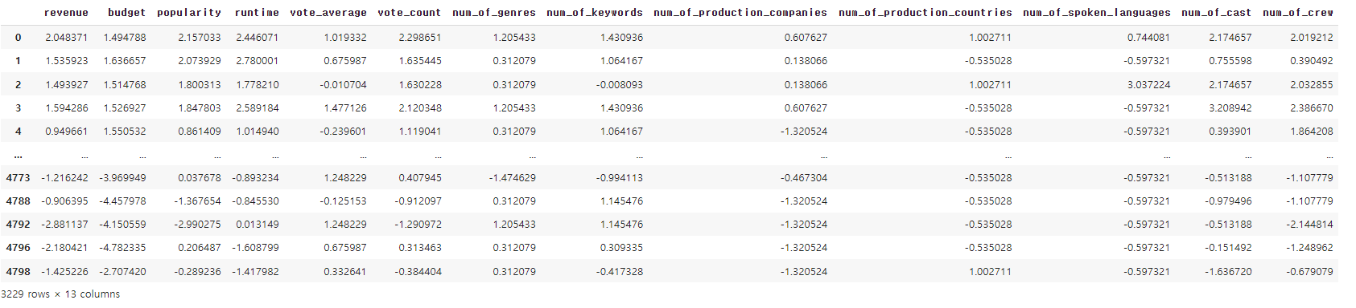
01. TMDB Dataset
02. Data Pre-Processing
03. Movie Trend
04. Revenue Analysis
05. Future analysis
04. Revenue Analysis
Standardization
→ QQ plot
[Final Dataset]
Lee Jeong Yoon, Stony Brook University

Slide 22
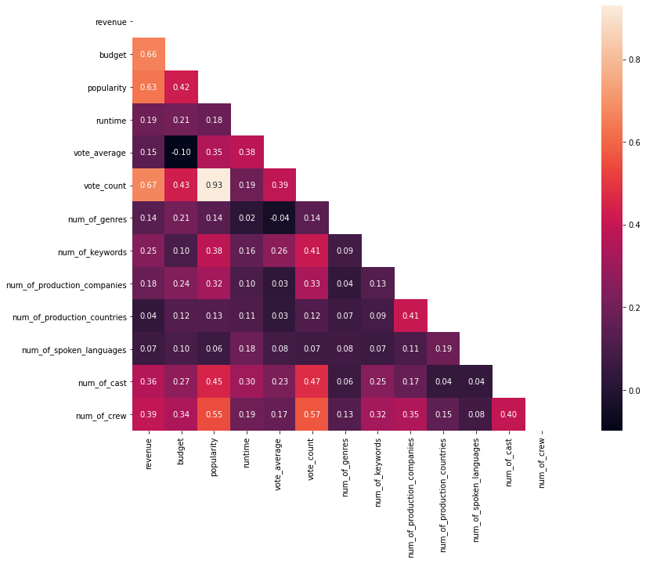
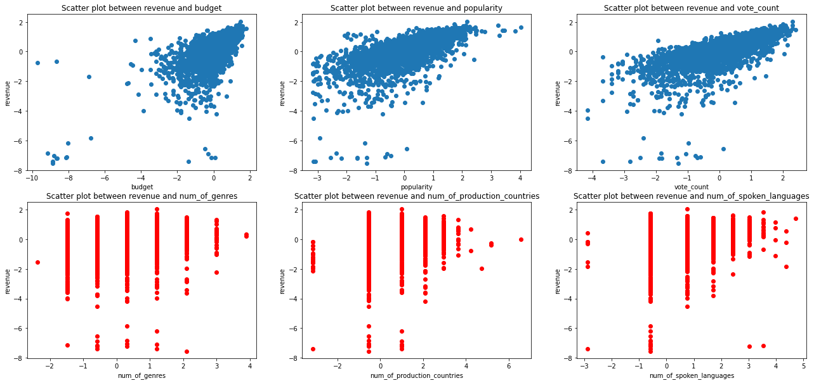
01. TMDB Dataset
02. Data Pre-Processing
03. Movie Trend
04. Revenue Analysis
05. Future analysis
04. Revenue Analysis
Correlation(Pearson)
Lee Jeong Yoon, Stony Brook University

Slide 23
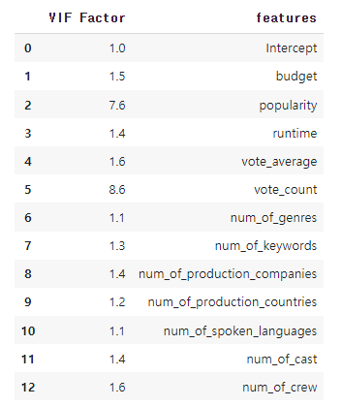
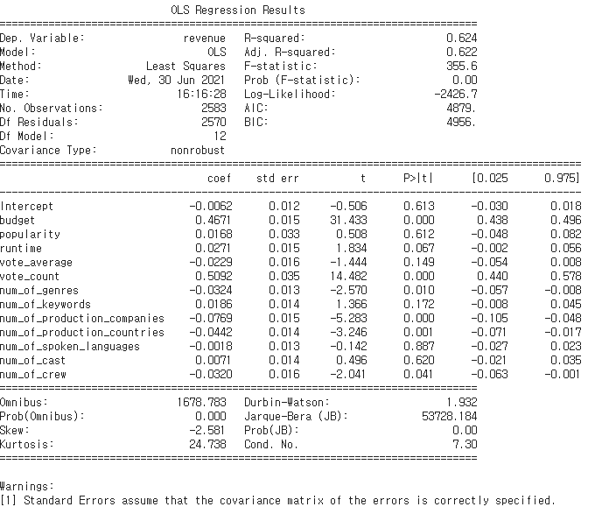
01. TMDB Dataset
02. Data Pre-Processing
03. Movie Trend
04. Revenue Analysis
05. Future analysis
04. Revenue Analysis
* Train Data : Test Data = 8:2
Regression Feature Selection (Backward Stepwise)
1. Check Multicollinearity
2. Check P-value
*confidence level : 95%
Lee Jeong Yoon, Stony Brook University
→ Popularity and vote_count features’ VIF score is relatively high, but they are less than 10, so we can use them just for now.

Slide 24
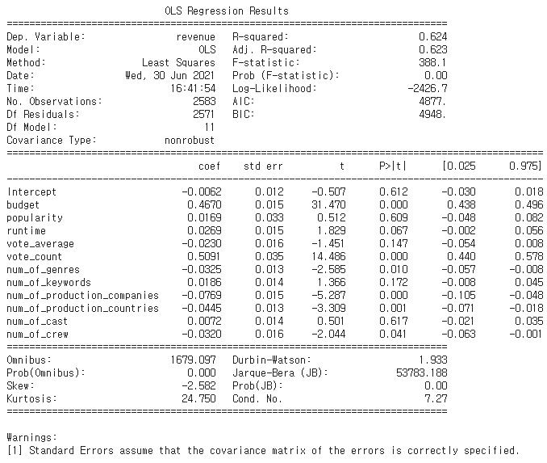
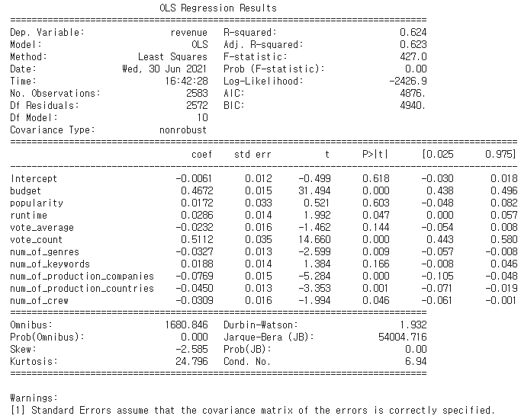




01. TMDB Dataset
02. Data Pre-Processing
03. Movie Trend
04. Revenue Analysis
05. Future analysis
04. Revenue Analysis
Regression Feature Selection (Backward Stepwise)
3. Keep Checking P-value
*confidence level : 95%
*if you want to add popularity and vote_count features in this model,
we should do dimension reduction like PCA analysis or SVM.
Lee Jeong Yoon, Stony Brook University

Slide 25




01. TMDB Dataset
02. Data Pre-Processing
03. Movie Trend
04. Revenue Analysis
05. Future analysis
04. Revenue Analysis
Regression Feature Selection (Backward Stepwise)
[ Simple Regression model]
R-square : 0.623
Regression Equation :
Y = 0.4741*(budget) + 0.5125(vote_count) – 0.0328(num_of_genre) – 0.0809(num_of_production_companies) – 0.0434(num_of_production_countries)-0.0064
4. Final Features
*Final Features
[QQ Plot]
[RMSE]
Lee Jeong Yoon, Stony Brook University

Slide 26





01. TMDB Dataset
02. Data Pre-Processing
03. Movie Trend
04. Revenue Analysis
05. Future analysis
04. Revenue Analysis
Regression Model 1 – Linear Regression
Y = 0.4741*(budget) + 0.5125(vote_count) – 0.0328(num_of_genre) –0.0809(num_of_production_companies) – 0.0434(num_of_production_countries)-0.0064
Lee Jeong Yoon, Stony Brook University

Slide 27






01. TMDB Dataset
02. Data Pre-Processing
03. Movie Trend
04. Revenue Analysis
05. Future analysis
04. Revenue Analysis
Regression Model 2 – Ridge Regression
Y = 0.4741*(budget) + 0.5124(vote_count) – 0.0327(num_of_genre) –0.0809(num_of_production_companies) – 0.0434(num_of_production_countries)-0.0064
Lee Jeong Yoon, Stony Brook University

Slide 28







01. TMDB Dataset
02. Data Pre-Processing
03. Movie Trend
04. Revenue Analysis
05. Future analysis
Lasso
Ridge
04. Revenue Analysis
Regression Model 3 – ElasticNet Regression
Y = 0.4668*(budget) + 0.503(vote_count) – 0.025(num_of_genre) –0.0724(num_of_production_companies) – 0.0403(num_of_production_countries)-0.0064
Lee Jeong Yoon, Stony Brook University

Slide 29
01. TMDB Dataset
02. Data Pre-Processing
03. Movie Trend
04. Revenue Analysis
05. Future analysis
04. Revenue Analysis
Model Comparison
Train Accuracy
Test Accuracy
RMSE
Regression Model 1 – Linear Regression
62.2%
64.5%
0.6203
Regression Model 2 – Ridge Regression
62.3%
64.3%
0.6203
Regression Model 3 – ElasticNet Regression
62.2%
64.6%
0.6205
Y = 0.4741*(budget) + 0.5124(vote_count) – 0.0327(num_of_genre) –0.0809(num_of_production_companies) – 0.0434(num_of_production_countries)-0.0064
Lee Jeong Yoon, Stony Brook University

Slide 30
Thank You!
Lee Jeong Yoon, Stony Brook University

